Slide 1
Course : Scientific Computing
Effective Period : Februari 2022
Getting Started with Python Session 1

Slide 2
Learning Objectives
Implement basic scientific computation using Python

Slide 3
Python with Google Colaboratory Environment

Slide 4
Google Collab Introduction
Google is quite aggressive in AI research. Over many years, Google developed AI framework called TensorFlow and a development tool called Colaboratory. Today TensorFlow is open-sourced and since 2017, Google made Colaboratory free for public use. Colaboratory is now known as Google Colab or simply Colab.
Another attractive feature that Google offers to the developers is the use of GPU. Colab supports GPU and it is totally free. The reasons for making it free for public could be to make its software a standard in the academics for teaching machine learning and data science. It may also have a long term perspective of building a customer base for Google Cloud APIs which are sold per-use basis.

Slide 5
What Colab Offers
Write and execute code in Python
Document your code that supports mathematical equations
Create/Upload/Share notebooks
Import/Save notebooks from/to Google Drive
Import/Publish notebooks from GitHub
Import external datasets e.g. from Kaggle
Integrate PyTorch, TensorFlow, Keras, OpenCV
Free Cloud service with free GPU

Slide 6
Create Python Notebook
Step 1: Open the following URL in your browser: htps://colab.research.google.com

Slide 7
Create Python Notebook
Step 2: Click on the NEW PYTHON 3 NOTEBOOK link at the bottom of the screen. A new notebook would open up as shown in the screen below.

Slide 8
Setting Notebook Name
By default, the notebook uses the naming convention UntitledXX.ipynb. To rename the notebook, click on this name and type in the desired name in the edit box as shown here:
We will call this notebook as MyFirstColabNotebook. So type in this name in the edit box and hit ENTER. The notebook will acquire the name that you have given now.

Slide 9
Entering and Executing Code
Enter the following two Python statements in the code window:
import time
print(time.ctime())

Slide 10
Adding Code Cells
To add more code to your notebook, select the following menu options: Insert / Code Cell
Alternatively, just hover the mouse at the bottom center of the Code cell. When the CODE and TEXT buttons appear, click on the CODE to add a new cell. This is shown in the screenshot below:

Slide 11
Changing Cell Order
When your notebook contains a large number of code cells, you may come across situations where you would like to change the order of execution of these cells. You can do so by selecting the cell that you want to move and clicking the UP CELL or DOWN CELL buttons shown in the following screenshot:

Slide 12
Deleting Cell
During the development of your project, you may have introduced a few now-unwanted cells in your notebook. You can remove such cells from your project easily with a single click. Click on the vertical-dotted icon at the top right corner of your code cell.

Slide 13
Variables and Assignment

Slide 14
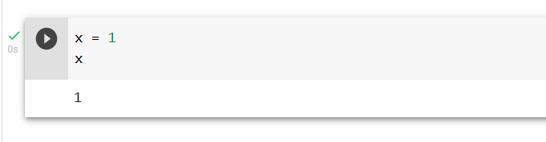
Variable and Assignment
A variable is a string of characters and numbers associated with a piece of information.
The assignment operator, denoted by the “=” symbol, is the operator that is used to assign values to variables in Python. The line x=1 takes the known value, 1, and assigns that value to the variable with name “x”.
After executing this line, this number will be stored into this variable. Until the value is changed or the variable deleted, the character x behaves like the value 1.

Slide 15
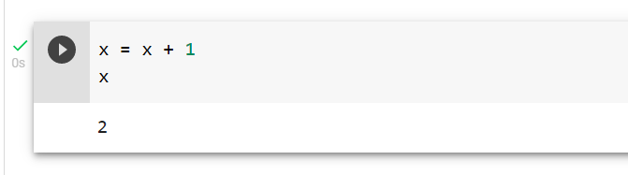
Variable and Assignment
The mathematical statement x=x+1 has no solution for any value of x. In programming, if we initialize the value of x to be 1, then the statement makes perfect sense. It means, “Add x and 1, which is 2, then assign that value to the variable x”.

Slide 16
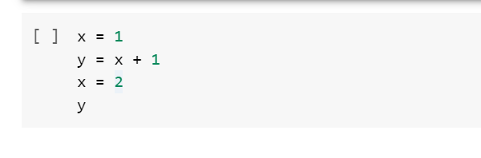
What value will y have after the following lines of code are executed?

Slide 17
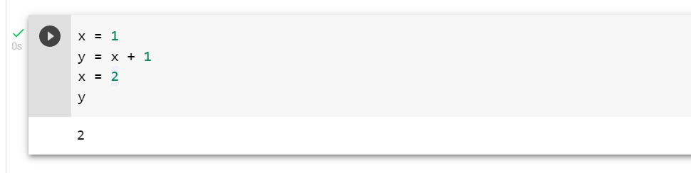
What value will y have after the following lines of code are executed?

Slide 18
Data Type and Numpy Arrays

Slide 19
By default Python have these data types:
strings - used to represent text data, the text is given under quote marks. e.g. "ABCD"
integer - used to represent integer numbers. e.g. -1, -2, -3
float - used to represent real numbers. e.g. 1.2, 42.42
boolean - used to represent True or False.
complex - used to represent complex numbers. e.g. 1.0 + 2.0j, 1.5 + 2.5j

Slide 20

Introduction Numpy
NumPy is important in scientific computing, it is coded both in Python and C (for speed). On its website, a few important features for Numpy is listed:
a powerful N-dimensional array object
sophisticated (broadcasting) functions
tools for integrating C/C++ and Fortran code
useful linear algebra, Fourier transform, and random number capabilities
Import Numpy Library:

Slide 21
Data Types in NumPy
NumPy has some extra data types, and refer to data types with one character, like i for integers, u for unsigned integers etc.
i - integer
b - boolean
u - unsigned integer
f - float
c - complex float
m - timedelta
M - datetime
O - object
S - string
U - unicode string
V - fixed chunk of memory for other type ( void )

Slide 22

Numpy Array
Create the following arrays:
$\left(\begin{matrix}1 & 4 & 3\end{matrix}\right)$
$\left(\begin{matrix}1 & 4 & 3 \\ 9 & 2 & 7\end{matrix}\right)$

Slide 23
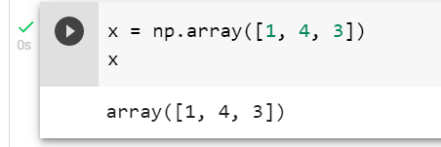
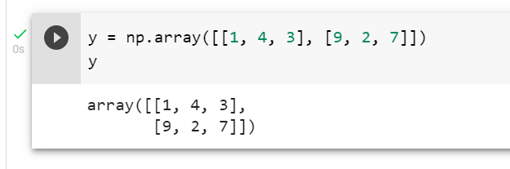
Numpy Array
Create the following arrays:
$\left(\begin{matrix}1 & 4 & 3\end{matrix}\right)$
$\left(\begin{matrix}1 & 4 & 3 \\ 9 & 2 & 7\end{matrix}\right)$

Slide 24
Function

Slide 25
Function
Function header: A function header starts with a keyword def, followed by a pair of parentheses with the input arguments inside, and ends with a colon (:)
Function Body: An indented (usually four white spaces) block to indicate the main body of the function. It consists 3 parts:
Descriptive string: A string that describes the function that could be accessed by the help() function or the question mark. You can write any strings inside, it could be multiple lines.
Function statements: These are the step by step instructions the function will execute when we call the function. You may also notice that there is a line starts with ‘#’, this is a comment line, which means that the function will not execute it.
Return statements: A function could return some parameters after the function is called, but this is optional, we could skip it. Any data type could be returned, even a function, we will explain more later.

Slide 26
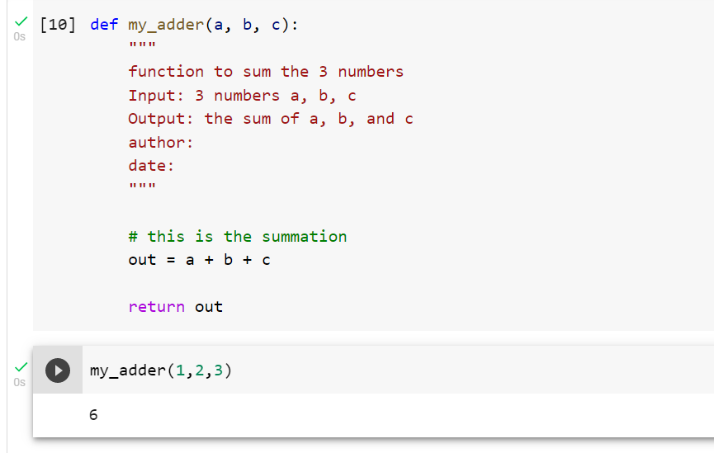
Example Function

Slide 27
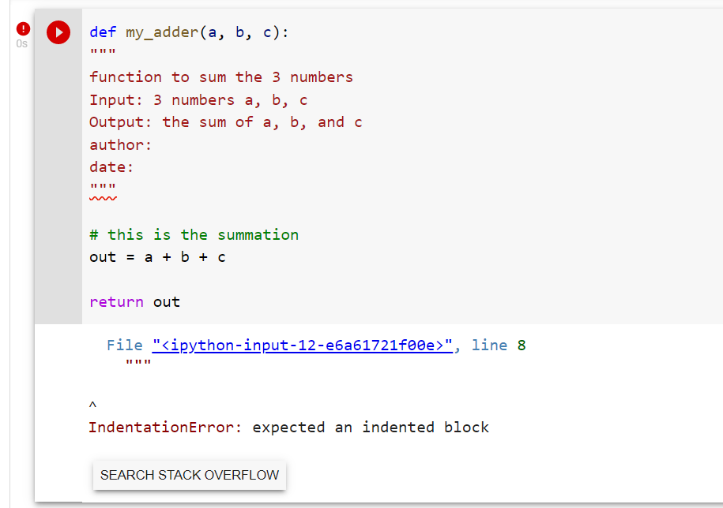
WARNING! If you don’t indent you code for defining function, you will get an IndentationError.

Slide 28
Operation and Statements

Slide 29
If-Else Statement
A branching statement, If-Else Statement, or If-Statement for short, is a code construct that executes blocks of code only if certain conditions are met. These conditions are represented as logical expressions.
Simple If-Else Statement Syntax
Extended If-Else Statement Syntax
if logical expression:
code block
if logical expression P:
code block 1
elif logical expression Q:
code block 2
elif logical expression R:
code block 3
else:
code block 4

Slide 30
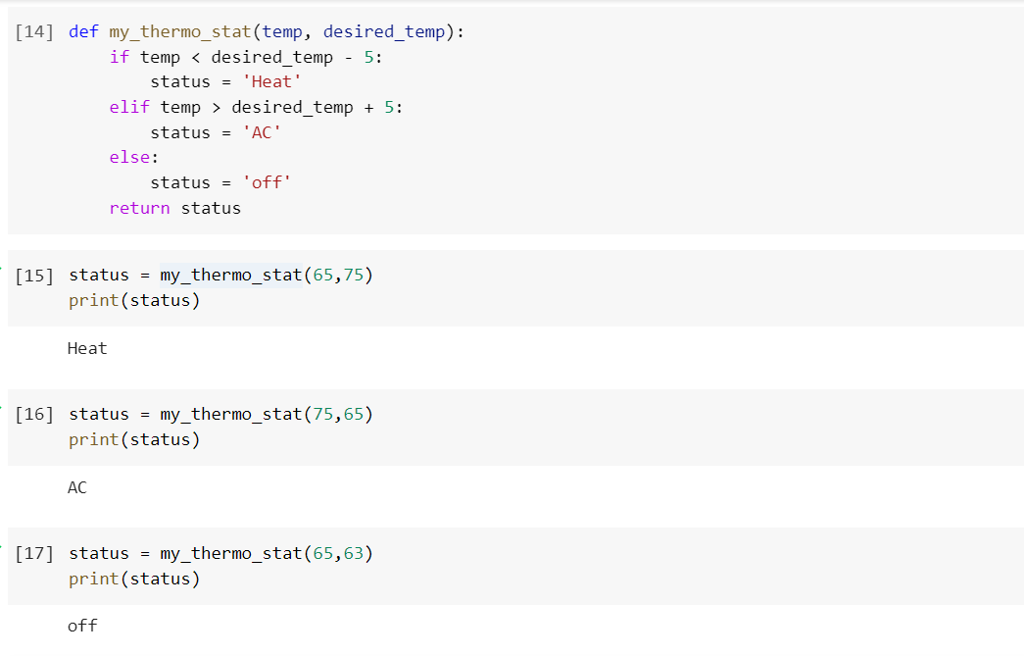
Example of If-Else Statement

Slide 31
What will be the value of y after the following script is executed?
x = 3
if x > 1 and x < 2:
y = 2
elif x > 2 and x < 4:
y = 4
else:
y = 0
print(y)
x = 3
if 1 < x < 2:
y = 2
elif 2 < x < 4:
y = 4
else:
y = 0
print(y)

Slide 32
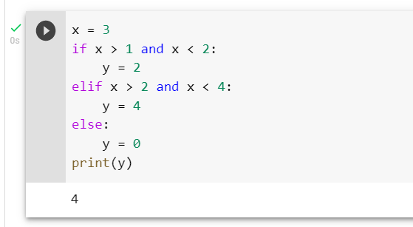
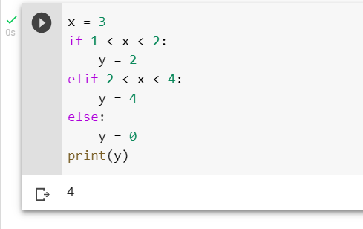
What will be the value of y after the following script is executed?

Slide 33
Pandas and Matplotlib library

Slide 34
matplotlib
In Python, the matplotlib is the most important package that to make a plot, you can have a look of the matplotlib gallery and get a sense of what could be done there. Usually the first thing we need to do to make a plot is to import the matplotlib package.

Slide 35
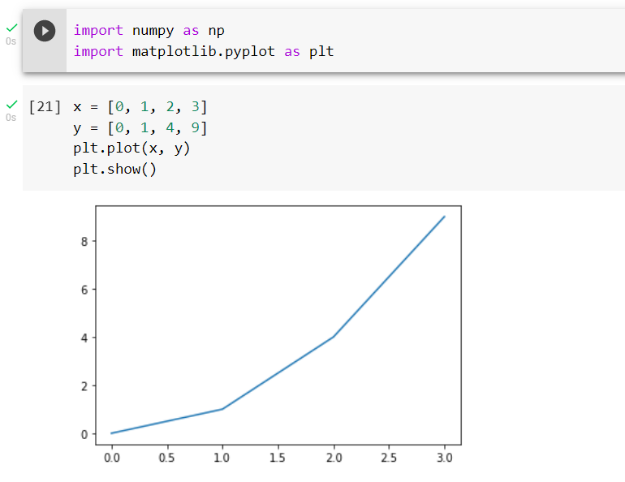

Slide 36
Pandas
Pandas is a Python library used for working with data sets.
It has functions for analyzing, cleaning, exploring, and manipulating data.
The name "Pandas" has a reference to both "Panel Data", and "Python Data Analysis" and was created by Wes McKinney in 2008.

Slide 37
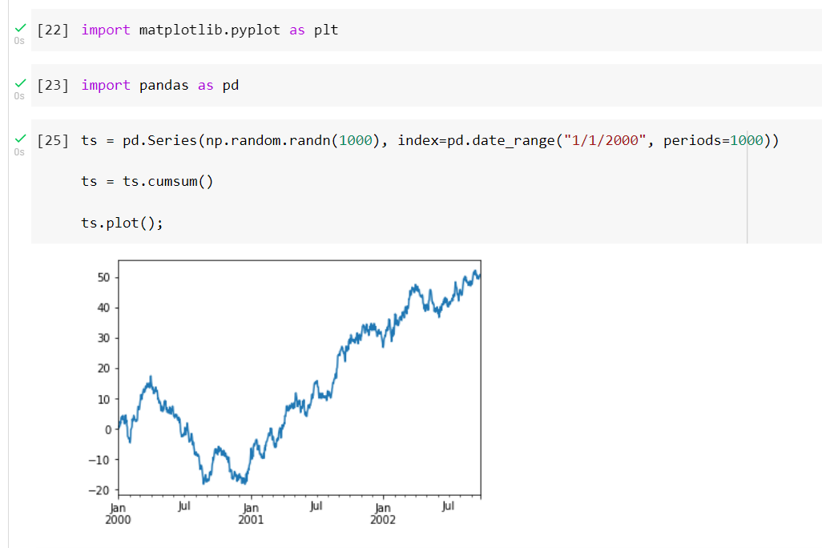
Example

Slide 38
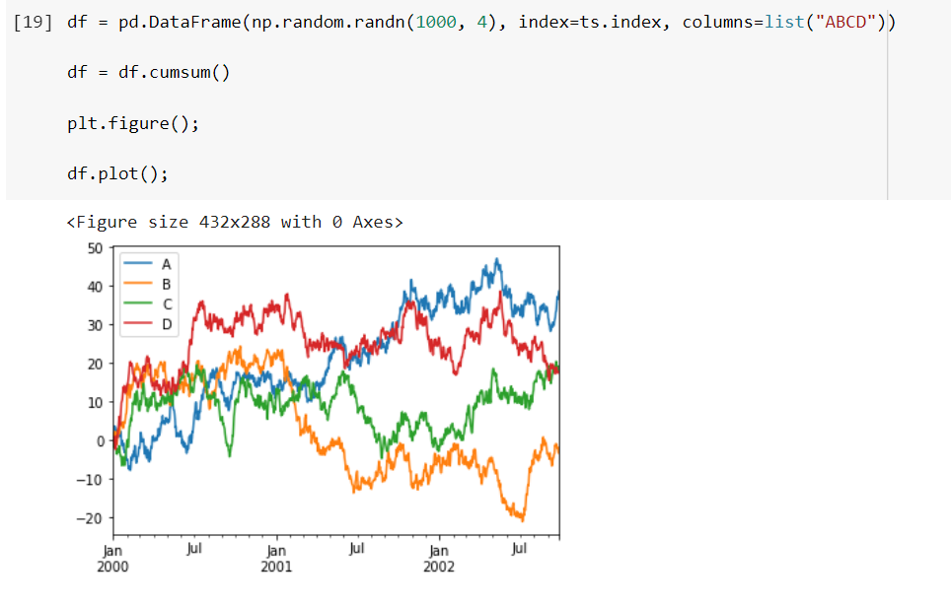

Slide 39
Exercise

Slide 41
References
Introduction Google Collabs [Video] https://www.youtube.com/watch?v=RLYoEyIHL6A
Book-1: Kong, Q., Siauw, T., & Bayen, A. M. (2021). Python Programming and Numerical Methods: A Guide for Engineers and Scientists. Academic Press. ISBN: 978-0-12-819549-9 (Chapter 1) (MM)
https://colab.research.google.com/github/jckantor/CBE30338/blob/master/docs/01.02-Python-Basics.ipynb#scrollTo=oxcXzg_JqDPE (SD)
Visualization and Plotting https://pythonnumericalmethods.berkeley.edu/notebooks/chapter12.00-Visualization-and-Plotting.html
https://pandas.pydata.org/docs/user_guide/visualization.html

